Slide 1
Secure your Web App in Azure

Slide 2

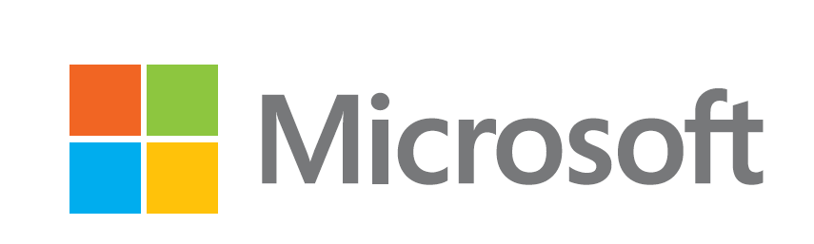







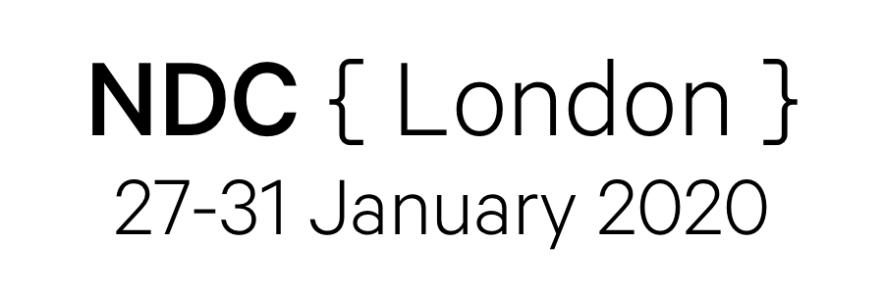



Sponsors
Notes:
Thank them
Microsoft – venue, catering
Black Marble – organisation/volunteers
iO Associates – Platinum Sponsors
DevExpress – speaker/volunteer shirts
Grey Matter – Gold sponsors
NDC, Landmark information, Sonoco Trident – Silver Sponsors
Global Data Sentinel – Agendas!
RevDeBug, Manning, Redgate – Bronze Sponsors

Slide 3
Introduction
Frans Lytzen, CTO NewOrbit
https://www.lytzen.name
@flytzen
Notes:
About me
My name is Frans Lytzen, I am CTO and co-founder of NewOrbit, we’re an Azure Gold Partner company based near Oxford.
Allow me to give you a bit of context.
We have been developing systems on Azure since 2011 for enterprises and startups. A lot of the systems we develop have very tight security requirements and we have been working closely with Microsoft as they have been massively increasing the tools and options you have for security in Azure.

Slide 4
Scope
Hosting a web app in Azure App Services
Functions are basically they same so what I say here goes for them too
There are a lot of concepts and tools – I will try to give you an overview so you can choose what is right for you
Many individual slides in this talk could fill the whole session.
I won’t – can’t – cover everything
It’s mainly infrastructure and configuration – but the few code examples are in .Net just because I use that most.
Notes:
I will give you a framework to allow you to think about this. I will talk about specific tools that fit into the different spaces in that framework.

Slide 5
Concepts

Slide 6
Understand your exposure
Internal actors are probably a bigger threat than external actors
Usually more through stupidity than evil intent
How sensitive is your data?
How bad would it actually be for your business if all the data in your system was leaked on the internet?
How likely are you to be directly targeted?
You are always vulnerable to “drive-by” attacks
There is no such thing as 100% secure – there is only “an appropriate security level for a given risk level”
Notes:
One customer of mine found that an operator was being “helpful” by emailing himself extracts of data from a highly sensitive system so they could work on some analysis at home.
Belgian bank example.

Slide 7
Concepts
Prevent
Detect
Mitigate
Notes:
Everyone is focused on Preventing external actors getting in. But you have to worry about internal actors now.
How do you know your system isn’t under attack right now? How do you know it hasn’t already been breached and your data is out on the dark web?
Finally; “assume breach” mindset – how do you mitigate the effect of someone breaching your system?

Slide 8
Concepts
 | External Actors | Internal Actors
PREVENT | Secure your code – see Troy Hunt’s courses as a starting point. Lock down your servers Use Firewalls and Intrusion Detection/Prevention Systems Encrypt everything in transit | Protect your passwords/secrets Process for granting and removing access Use Azure AD for all access, including SQL Audit who has access on a regular basis and remove unnecessary access
DETECT | Log and alert on any unusual application activity 403s and 404s Failed logins High CPU/memory, increased load Etc Use Advanced Threat Protection | Log and alert on all access to the backend by internal users Log and alert on unusual access patterns by application users Consider DLP tools
MITIGATE | Encrypt sensitive data at the application layer Have ways of locking out certain users or IP addresses For very sensitive systems, consider multi-layered architectures to contain breaches
Notes:
Most developer who think about security think about how to stop an attacker hacking your application. That is only the first step.

Slide 9
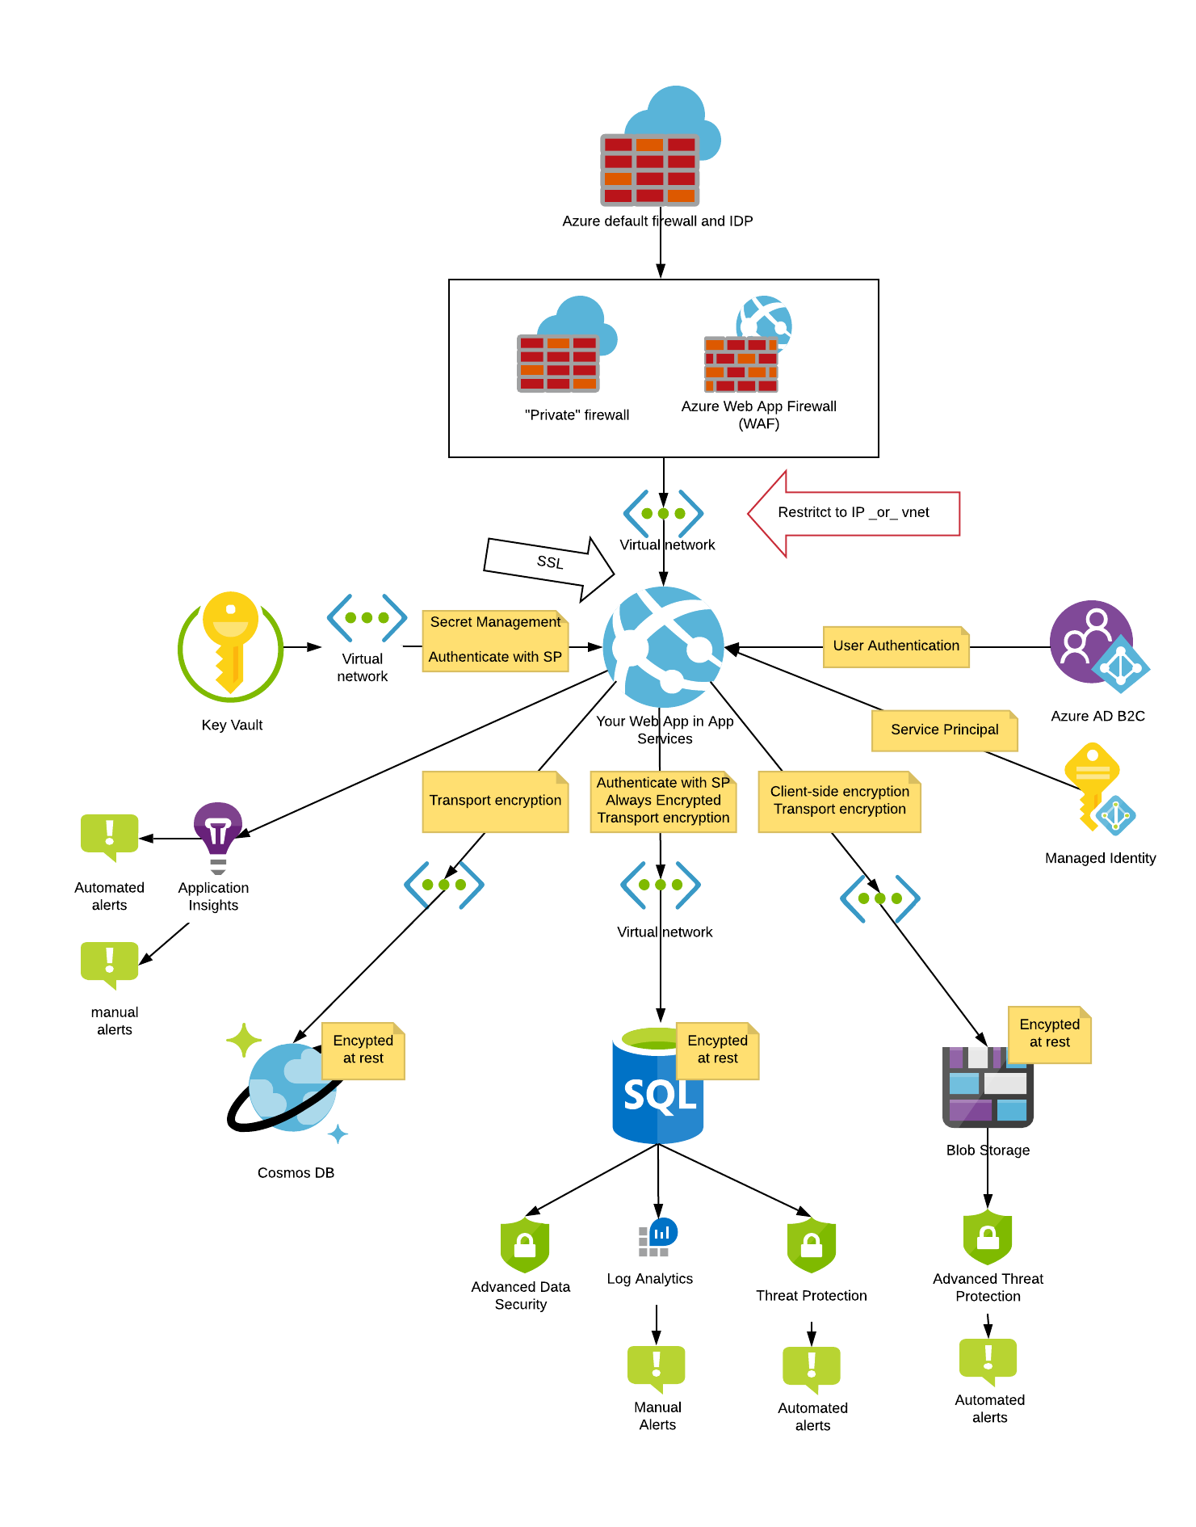
Idealised
Getting in
Secret Management
Network Isolation
Encryption
Detection

Slide 10
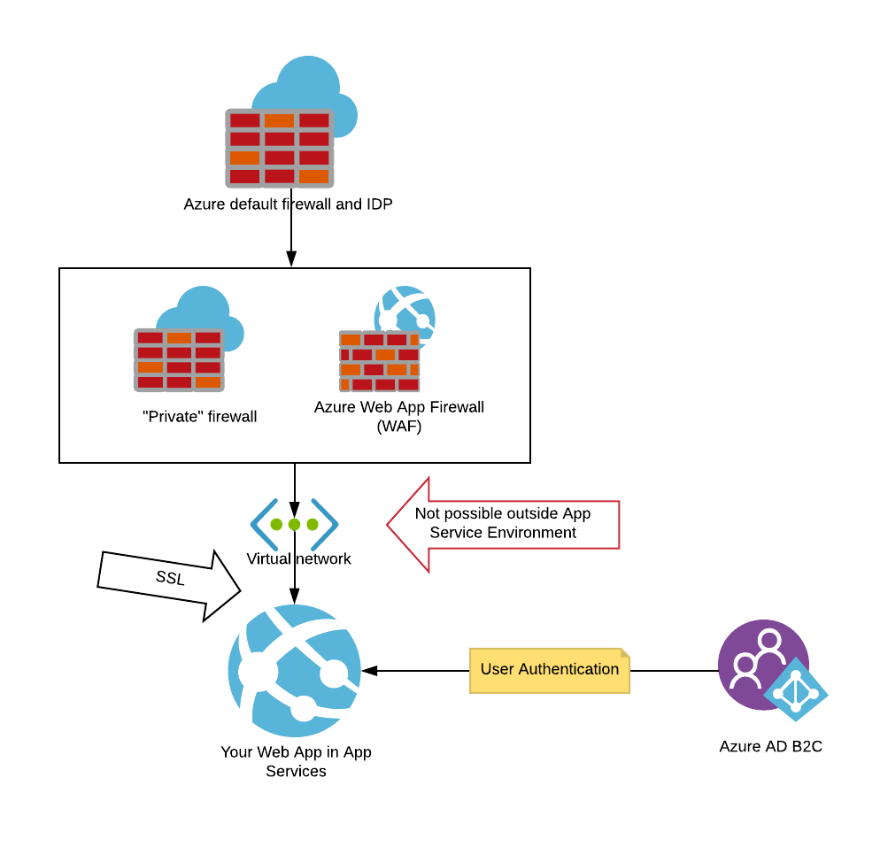
Getting in

Slide 11
Make your code secure
Watch Troy Hunt’s courses a starting point
Notes:
There is no substitute for this – no fancy tech is going to protect you if your code sucks. So start here.

Slide 12
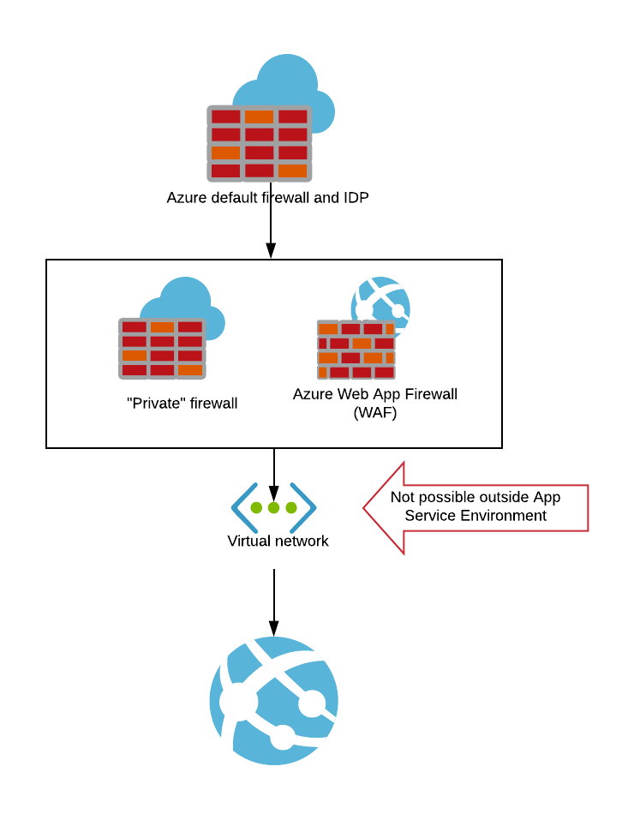
Firewalls
You can’t put an Azure Web App behind a virtual network; it is always open to the internet (except in the context of restricting access for micro services)
You can restrict access to only some IPs
Azure’s Virtual Network Appliances, such as Firewalls are therefore of limited value.
You can do this with “App Service Environment” – but it will cost you.
Azure does give you some firewall, IPS and DDoS capabilities by default; you can’t access or see them and they may be more permissive than you want.
Notes:
The point is that Azure already gives you a firewall

Slide 13
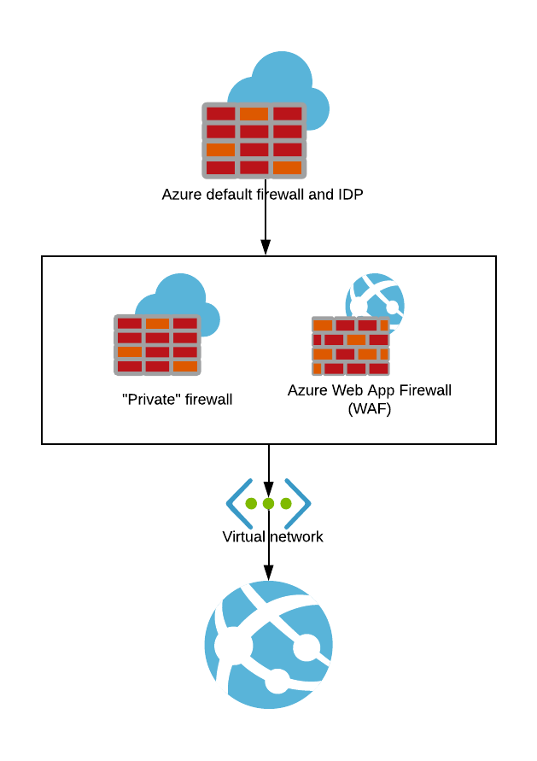
Can I have my own firewall?
Can I have my own firewall?
Not really, no – but you don’t need it.
Can I use a WAF (Web Application Firewall)?
Yes – if you must.
You can limit access to your web app to specific IP addresses (i.e. the WAF).
You can configure a Web App to only accept traffic from a certain vnet, but that is more for micro-services or for gateways to on-premise networks.
Notes:
I don’t recommend Azure’s WAF, just from personal experience but there are other providers out there.

Slide 14
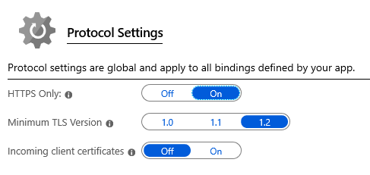
TLS/SSL
Require HTTPs for all traffic
Azure’s built-in “HTTPS Only” may interfere with “Always On”
Consider Let’s Encrypt Website Plugin for free, automated SSL Certificates.
BUT: It requires you to put powerful credentials in clear-text in the app configuration settings.
App Service Certificates allows you to buy SSL certificates from Microsoft, directly in the portal.
Azure CDN includes free SSL certificates.
Remember to talk to all your back-end dependencies using TLS as well.

Slide 15
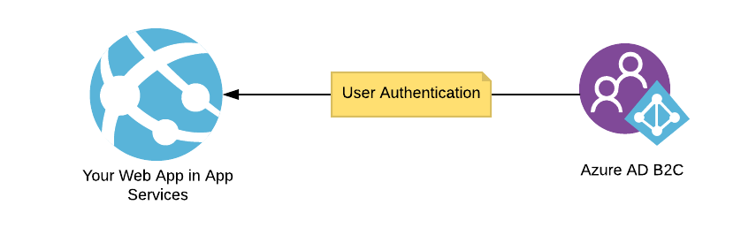
ADB2C Authentication

Slide 16
ADB2C/AAD Authentication benefits
You can use Azure AD (i.e. Office 365 accounts) and/or Azure AD B2C to manage logins to your application.
ADB2C is “login as a service” that you can use for users in your application.
They both provide very powerful security features, including Multi Factor Authentication (MFA) and machine-learning based detection of suspicious logins.
Provides oAuth2 tokens for SPAs and other consumers.
Provides a sign-up flow as well (beware of 15 minute time limit)
Can integrate to other SSO providers

Slide 17
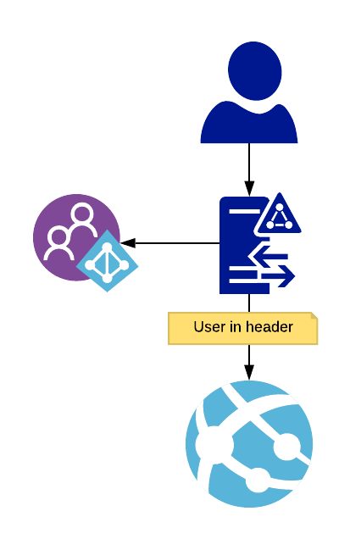
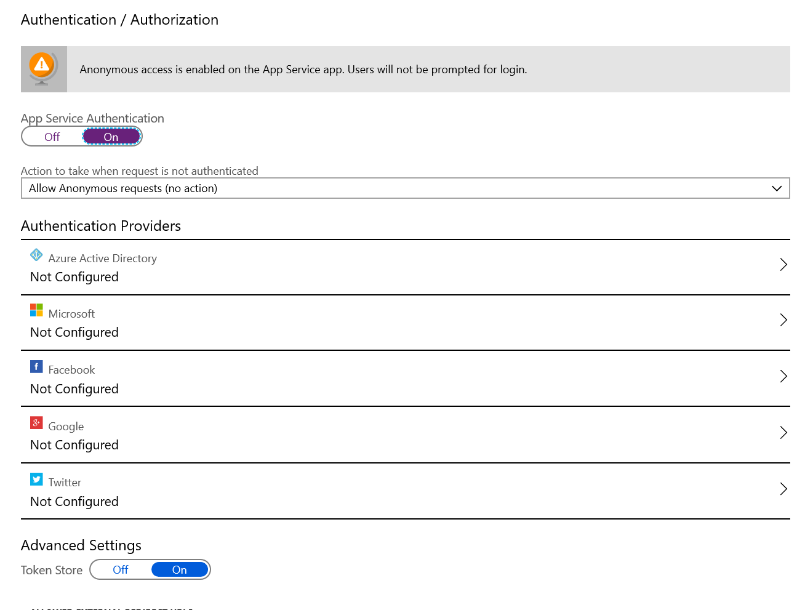
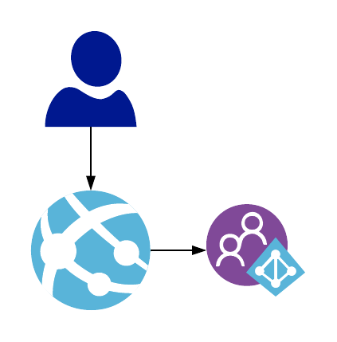
ADB2C / AAD Authentication options
Let Azure handle it all
Handle it in code
Notes:
“Azure handle it” is hard to test locally and gives you less flexibility – but it is very easy. Especially helpful with oAuth2.

Slide 18
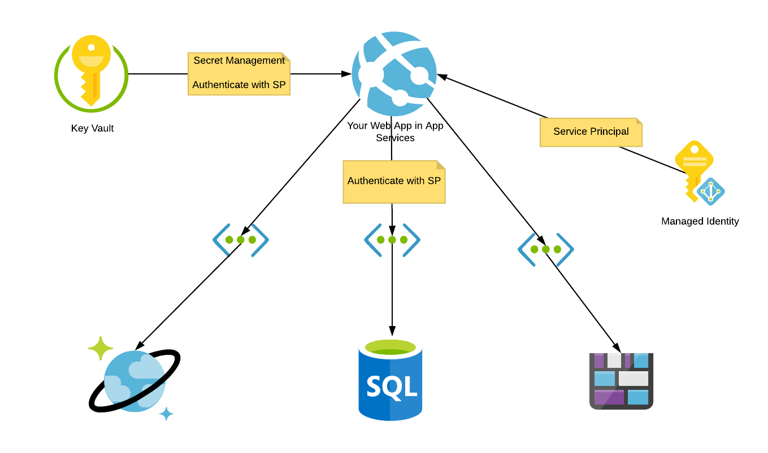
Secret management
Getting in
Secret Management
Network Isolation
Encryption
Detection
Avoid anyone being able to impersonate your application by not storing credentials in clear text

Slide 19
What you should achieve
Credentials for databases etc should not be stored anywhere where a developer or an ops person can get them.
Can be accidentally leaked. Password in source code, anyone?
You may not reset them when someone leaves.
Someone will use them to access the database etc – and you won’t know it was them.
Use Service Principals to authenticate to other services where possible.
Use Managed Identity so no-one “knows the password” for the application.

Slide 20
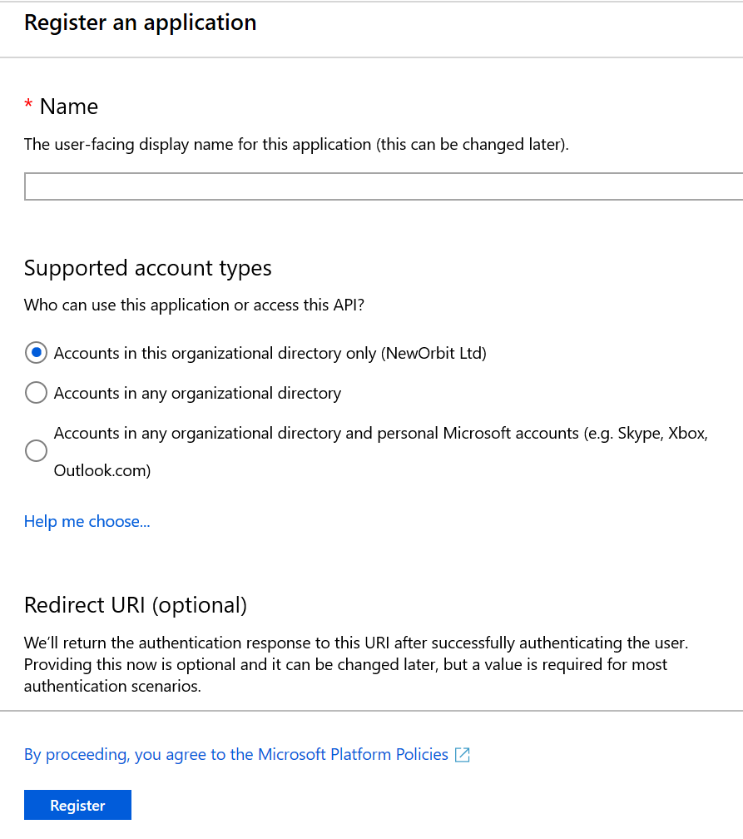
Service Principals
A Service Principal is really just an Azure AD user that is intended to be used by an application. It can have permissions and roles, just like a normal user.
Except, you have to “create an app” – which can be counter intuitive. Just embrace the weirdness.
In the portal, Azure Active Directory -> App Registration (choose Web and give it a dummy url)

Slide 21
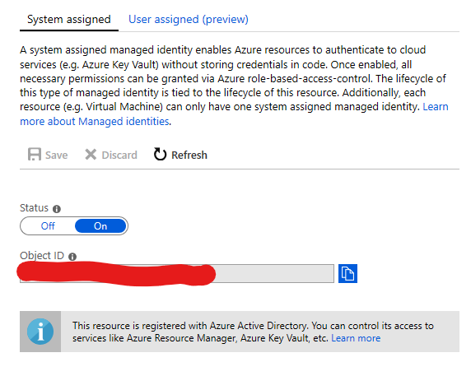
Managed Identity
Azure will create a Service Principal for your web app.
You can get a bearer token for that Service Principal using an API running on localhost on the Web App => It can only ever be used by your web app.
In C# it’s as simple as var atp = new AzureServiceTokenProvider();
(locally, that will seamlessly use your account instead)
Notes:
This is extremely cool. If you can find it in yourself to be excited about something in security – this is it!

Slide 22
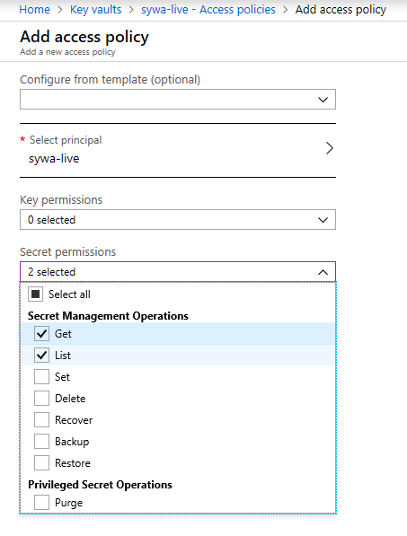
Use Azure Key Vault for Secrets
Add secrets, like Azure Storage connection strings in Azure Key Vault
Give your Web App’s Managed Identity Service Principal access to read the secrets
Add secrets to the Key Vault
Notes:
Remember Managed Identity? The combination of these two is epic.

Slide 23
Retrieve secrets from Key Vault
Nuget Packages: Microsoft.Azure.Services.AppAuthentication and Microsoft.Azure.KeyVault
General Purpose
ASP.Net Core Config Integration
using Microsoft.Azure.Services.AppAuthentication;
using Microsoft.Azure.KeyVault;
// Instantiate a new KeyVaultClient object, with an access token to Key Vault
var atp = new AzureServiceTokenProvider();
var kv = new KeyVaultClient(new KeyVaultClient.AuthenticationCallback(atp.KeyVaultTokenCallback));
// Retrieve an individual secret called "secret"
var secret = await kv.GetSecretAsync(
"https://[keyvaultname].vault.azure.net/secrets/secret");
var secretValue = secret.Value;
using Microsoft.Azure.Services.AppAuthentication;
using Microsoft.Azure.KeyVault;
var atp = new AzureServiceTokenProvider();
var kv = new KeyVaultClient(new KeyVaultClient.AuthenticationCallback(atp.KeyVaultTokenCallback));
var builder = new ConfigurationBuilder()
.AddJsonFile("appsettings.json")
.AddEnvironmentVariables()
.AddAzureKeyVault(
"https://[keyvaultname].vault.azure.net/",
kv, new DefaultKeyVaultSecretManager());;
Notes:
The AppAuthentication nuget package will automatically use your identity when developing locally, as long as you are domain joined to an Azure AD.
The ASP.Net Core config integration will automatically add all the secrets to your IConfiguration.

Slide 24
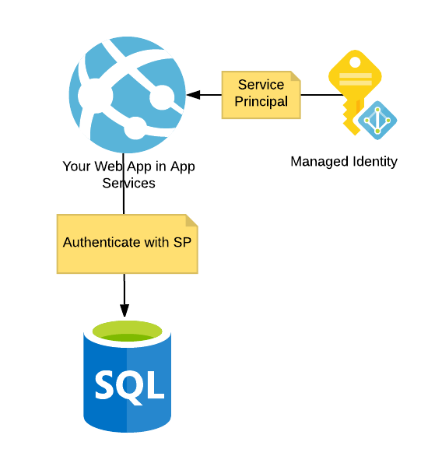
Connect to Azure SQL using Managed Identity
Add your Managed Identity Service principal as a user to the SQL Database.
It’s a bit long-winded how to do that properly so I will skip over it here. The easiest, but not best, way is to;
Create a Security Group in Azure AD
Add your Managed Identity Service Principal to that Group
Make that Group the “AD Admin” of your Azure SQL Server (not database)
Better way is to add the Service Principal as a user in SQL using T-SQL and giving it only the appropriate rights.

Slide 25
Connect to Azure SQL using Managed Identity
Remove Username and Password from your Connection String
Add a constructor like this to your DbContext:
public MyDatabaseContext(SqlConnection conn) : base(conn, true)
{
conn.ConnectionString = [retrieve connection string from config];
conn.AccessToken = (
new AzureServiceTokenProvider())
.GetAccessTokenAsync("https://database.windows.net/").Result;
}
Requires .Net 4.6 or .Net Core 2.2

Slide 26
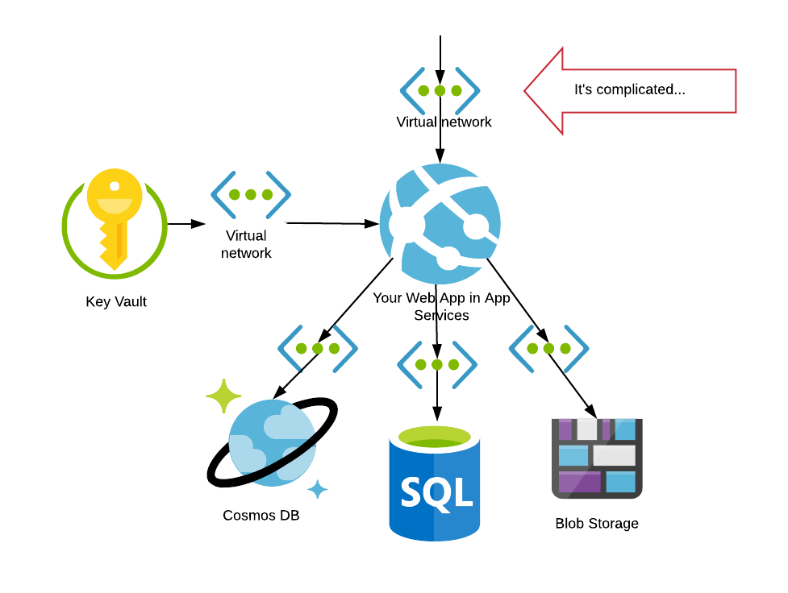
Network isolation
Getting in
Secret Management
Network Isolation
Encryption
Detection
Avoid people listening in and make it harder to attack

Slide 27
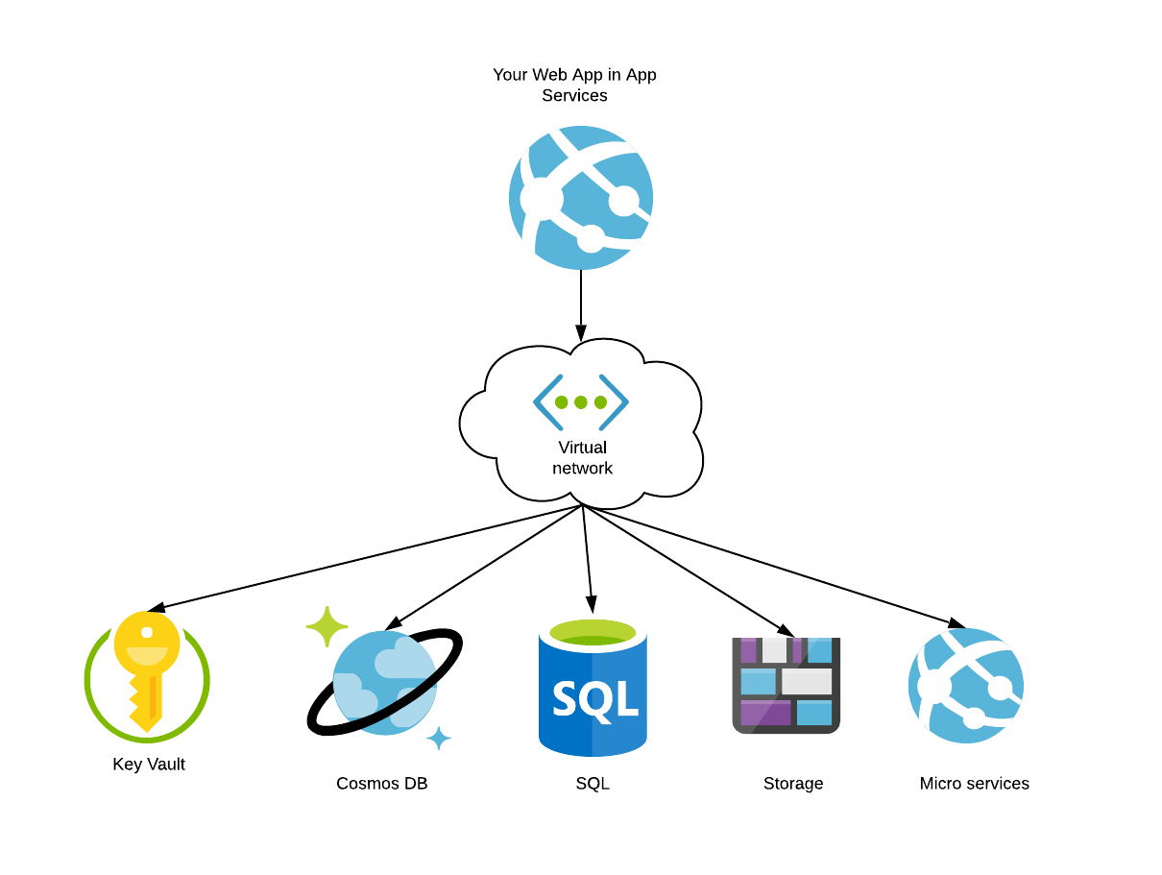
Limit access to back-end services
Create a Virtual Network and a Subnet
Add Service End Points for each type of Service
Restrict access to each service to limit it to only traffic from that vNet
Allow the Web App to use that vNet
There is a performance benefit too
Note: it often takes 15-30 minutes before changes take effect!
Only works with preview, which has other limitations.

Slide 28
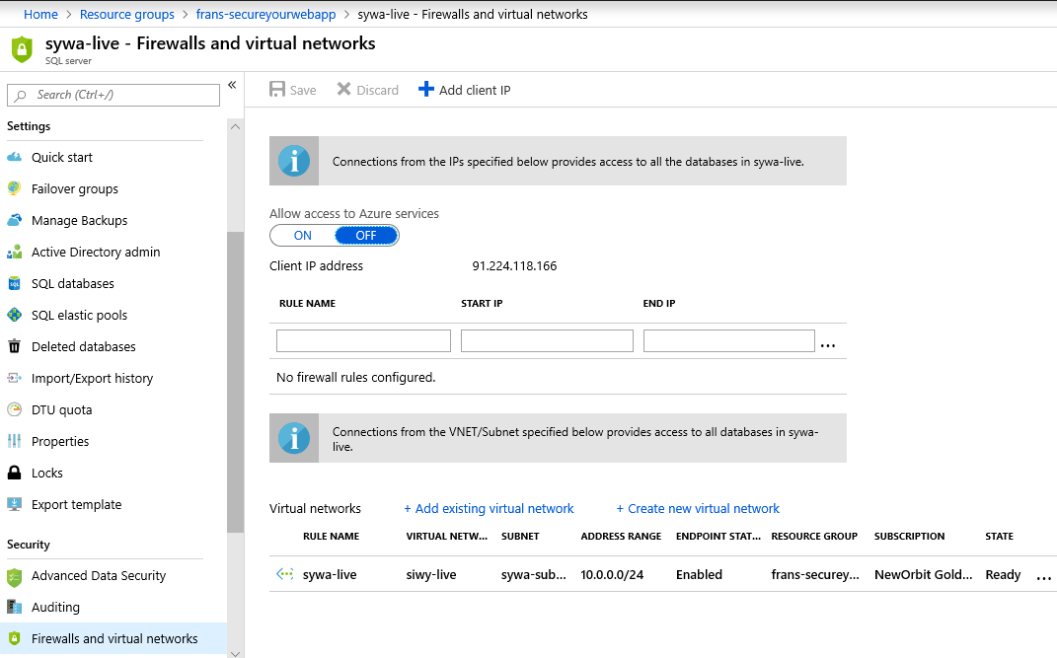
Block access to SQL Server

Slide 29
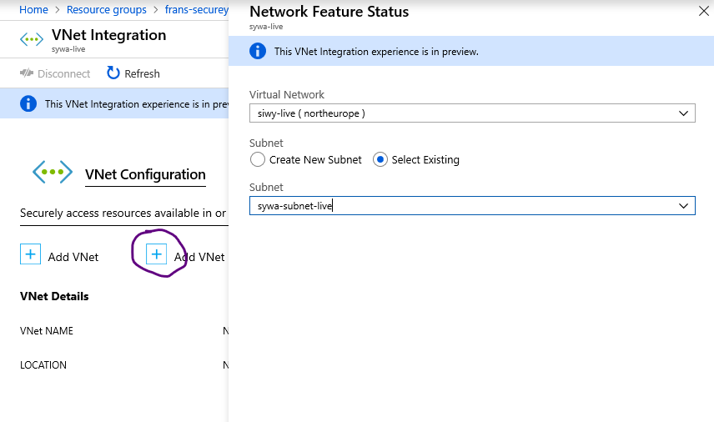
Allow Web App to use VNet

Slide 30
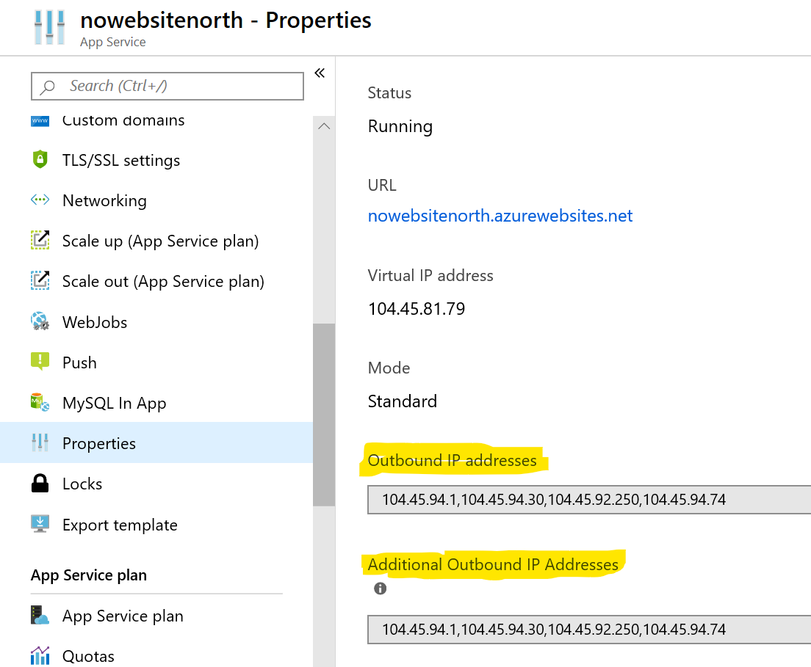
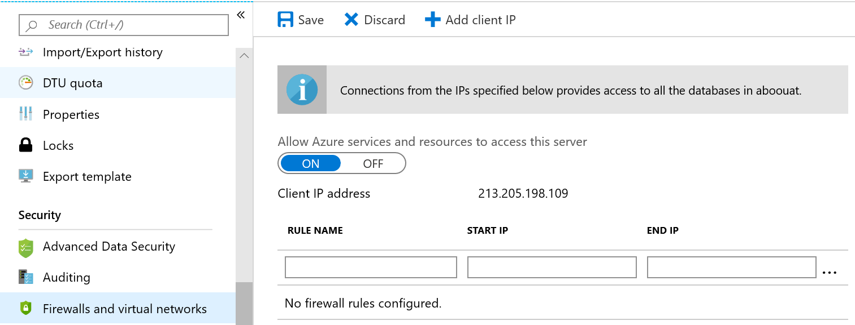
IP Restrictions instead
Virtual Networks in preview have limits
You can use IP address restrictions instead
Use the outbound IP addresses from your web app.
They can change.
They are shared with lots of other sites.
Databases and micro services can have inbound IP address range restrictions

Slide 31
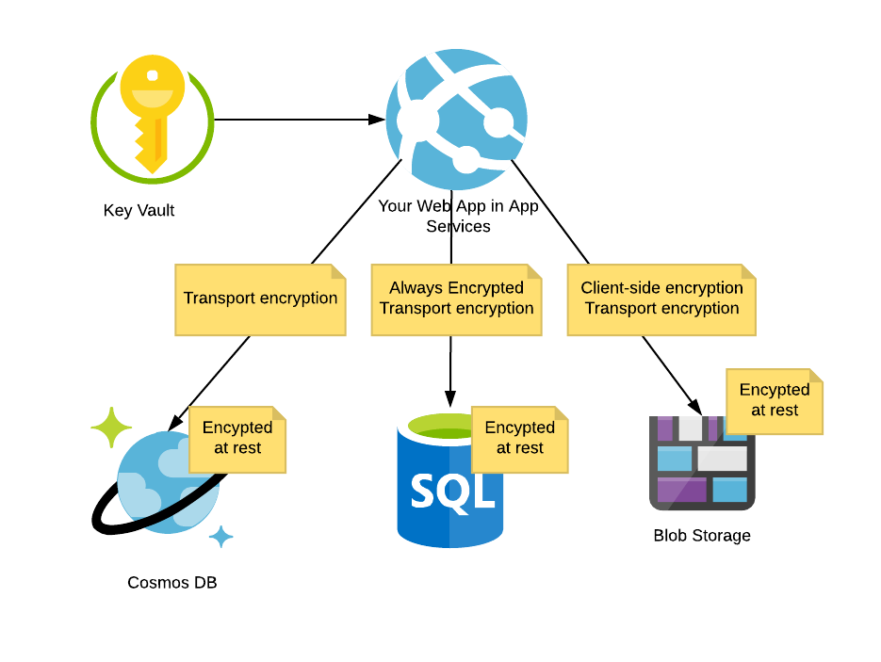
Encryption
Getting in
Secret Management
Network Isolation
Encryption
Detection

Slide 32
Layers
Transport Encryption
Encrypted on the wire
Encryption at Rest
The data is encrypted on the disk
Application-layer encryption
Encrypt data at the application layer so even users with access to the backend can’t read it.
SQL and Storage supports it
On by default
Check your connection strings and settings
On by default for almost everything
Meaningless, but a tick in a box
.Net Core support is coming

Slide 33
Storage Client-side encryption
Blobs, Tables and Queues are all supported, but obviously use different setups to function.
Azure Key Vault is used to automatically manage the secrets
The Storage libraries have native support for it.
Set up Key Vault using your Managed Identity as discussed above
Items will automatically be encrypted and decrypted with rotating keys.
Even users with legitimate access to your storage account will only see encrypted data

Slide 34
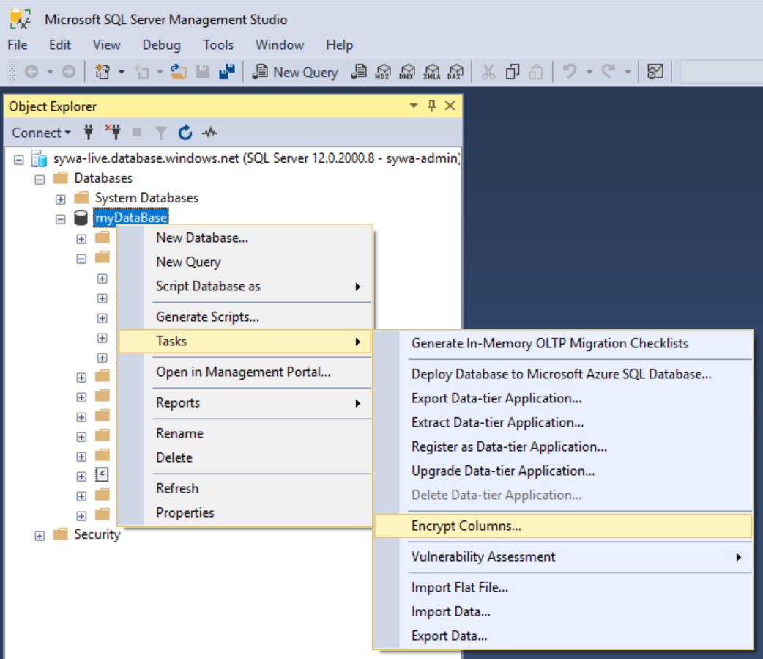
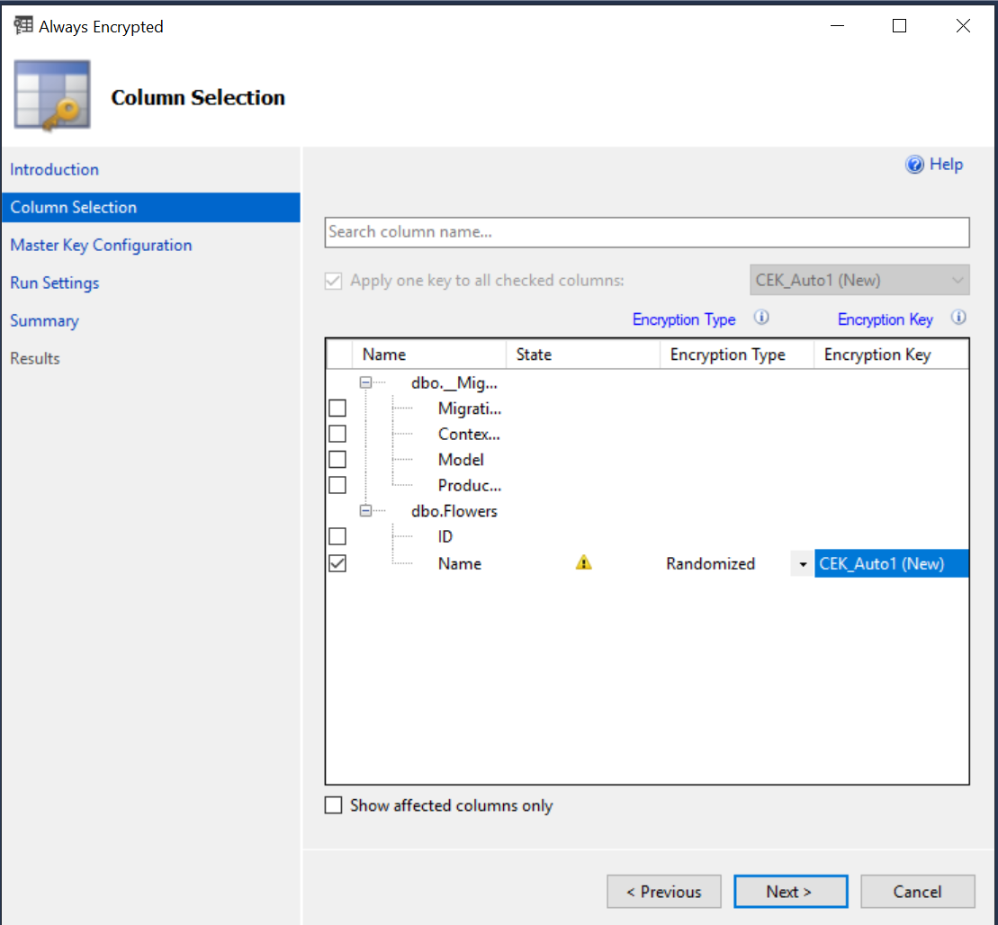
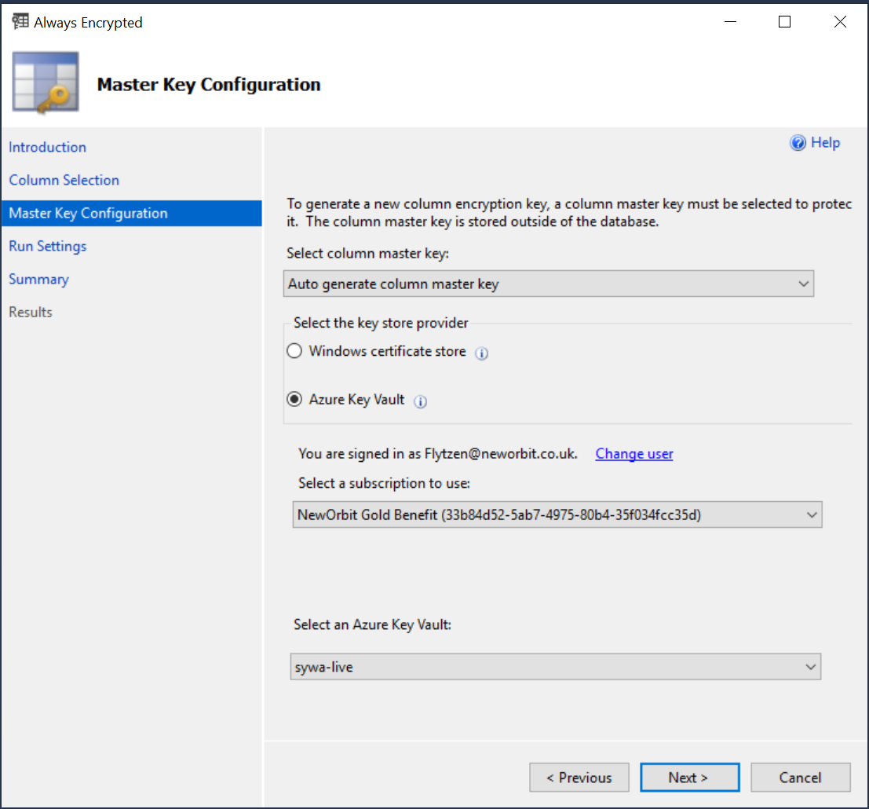
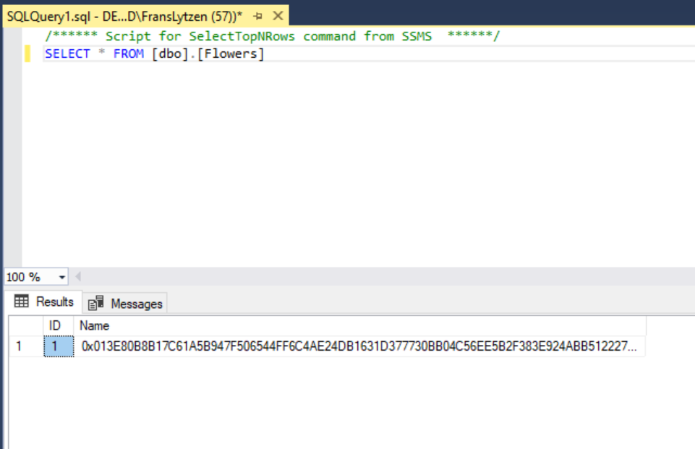
SQL Always Encrypted

Slide 35
SQL Always Encrypted
create, get, list, sign, verify, wrapKey, and unwrapKey Key Vault Policy permission are required.
Change your connection string to include ; Column Encryption Setting=enabled;
private static void TellEFToUseKeyVaultForConnections()
{
var providers = new Dictionary<string, SqlColumnEncryptionKeyStoreProvider>
{ { SqlColumnEncryptionAzureKeyVaultProvider.ProviderName,
new SqlColumnEncryptionAzureKeyVaultProvider(GetAuthToken) } };
// This is a static method
SqlConnection.RegisterColumnEncryptionKeyStoreProviders(providers);
}
// GetAuthToken is a KeyVault callback similar to what we did for authentication earlier
Notes:
Support for .Net Core is probably not there yet; noises about including in EF Core 3.0 but not sure if its in yet.

Slide 36
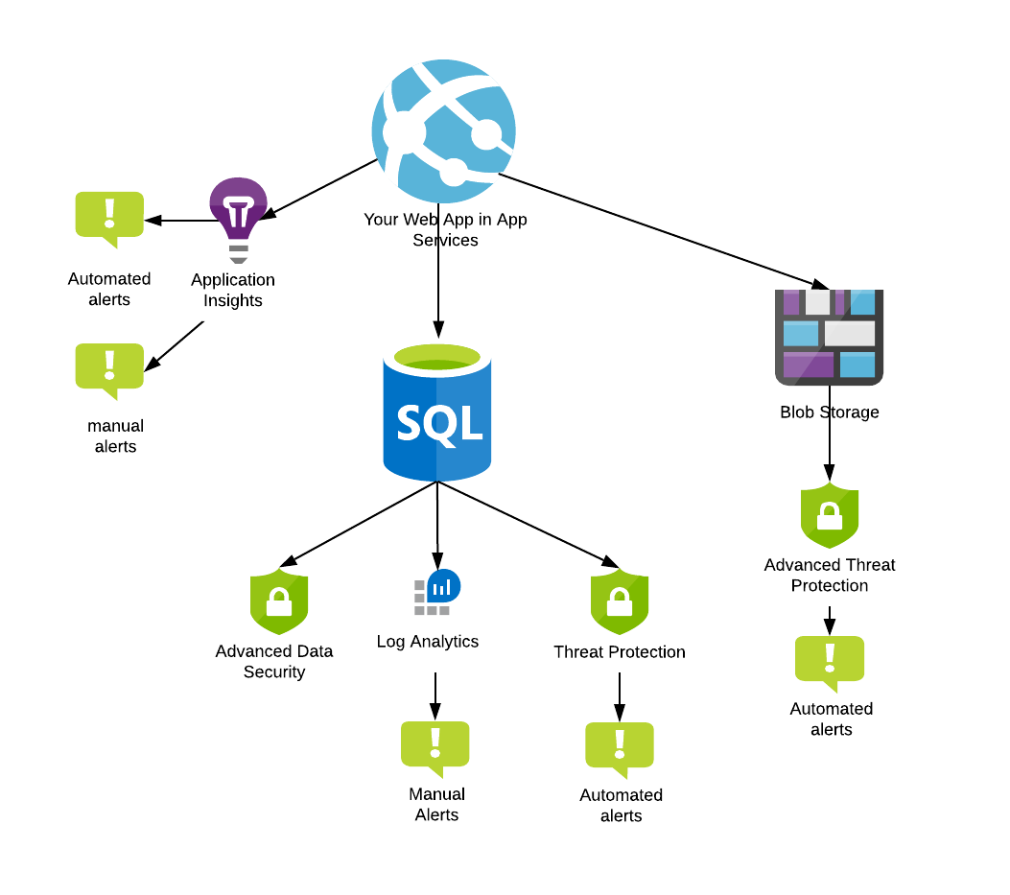
Detection
Getting in
Secret Management
Network Isolation
Encryption
Detection
How do you know you are being attacked? How do you know if your own people are accessing data they shouldn’t?

Slide 37
Automated alerts
Machine Learning-based tools to automatically tell when something is not normal

Slide 38
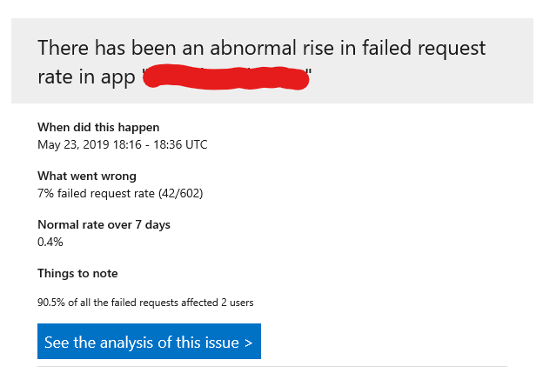
Application Insights
Just switch on Application Insights and it will “baseline” your application and alert you when things are “different to normal”.
Unless hackers are very careful, they will cause disturbances as they prod your system.

Slide 39
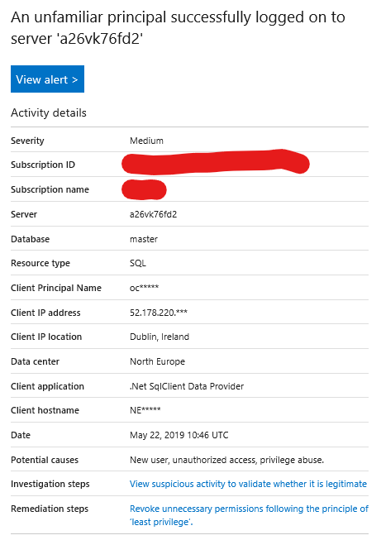
Threat Detection
Part of SQL Advanced Data Security
In preview for Storage
Base-lines “normal” behaviour in your app and alerts you to changes.
Detects SQL injection and other common attack patterns.

Slide 40
Manual Alerts
Look for specific patterns you know are suspicious
A rise in 404s may mean someone is scanning your app to find vulnerable URLs
A rise in 403s may mean an authenticated user is trying to escalate their privileges (basically trying to access URLs they are not meant to)
A rise in failed logins may mean someone is trying to guess a username/password
You need to know when your operators read data directly from SQL

Slide 41
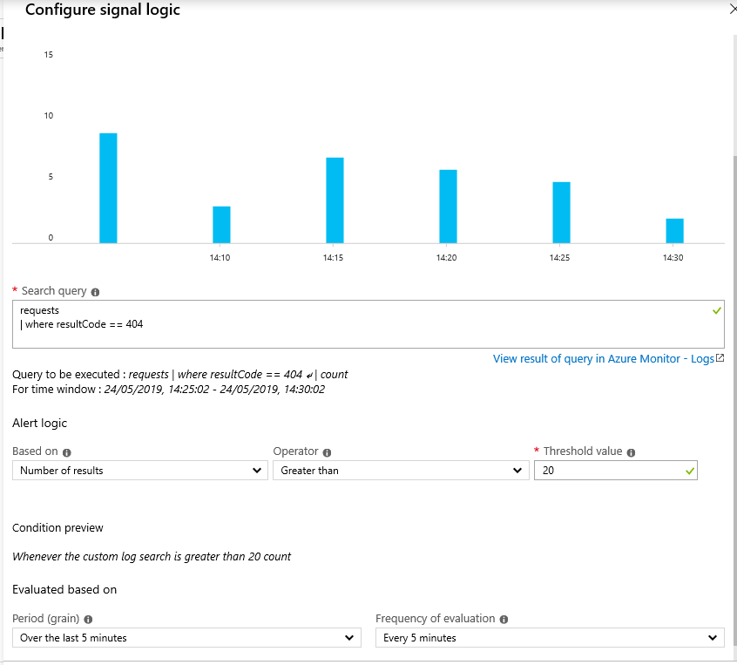
Alerts in Application Insights
Application Insights -> Analytics -> New Alert Rule
Create a search, tell it how often to run and when to email you.

Slide 42
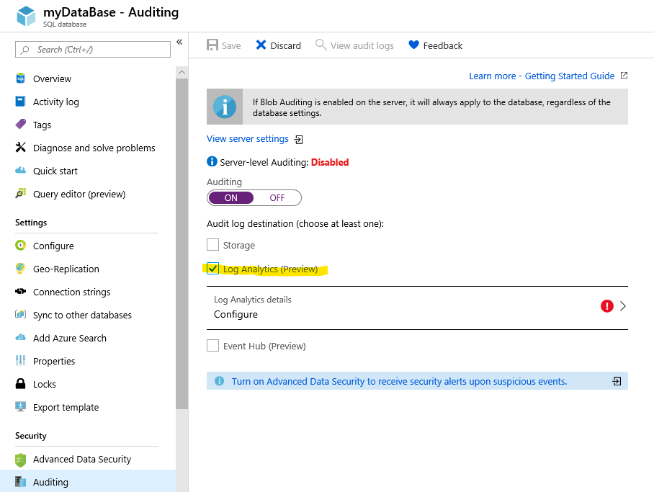
Alerts in SQL
Configure SQL to write all SQL statements to Log Analytics
Create an alert that tells you each day who – other than your application – logged in.

Slide 43
SQL Advanced Data Security
Includes Threat Detection
Analyses your database to find weaknesses, such as too many users etc.
Analyses your database to find potentially sensitive data.
A fantastic tool for compliance and ongoing monitoring.

Slide 44
Closing notes
Notes:
We have covered a huge amount today.
I think you can see that there are a lot of security tools in Azure you *can* use. I don’t think you should use them all.
If Compliance is very important to you – consider choosing SQL as it has the most security and compliance features.
Finally, do prioritise the monitoring and alerting side.

Slide 45

What Questions do you have?

